Slide 1
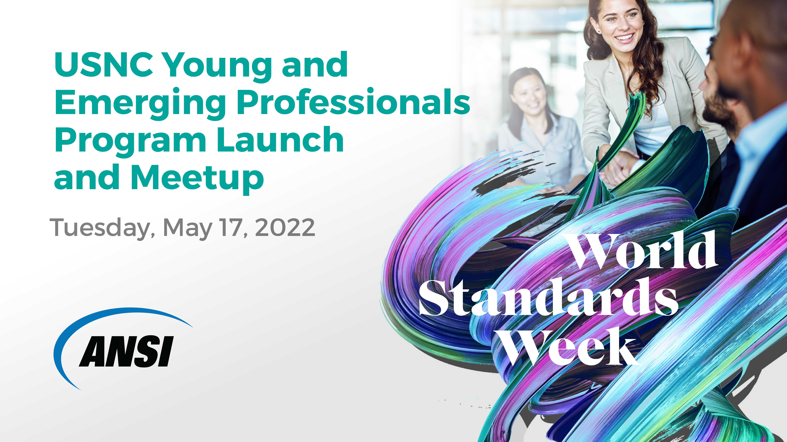
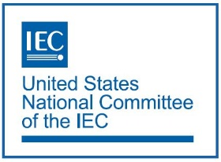
This webinar will be recorded.
Notes:
carrie

Slide 2
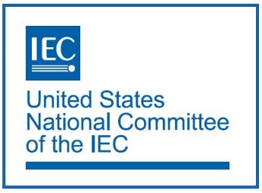
USNC YEP Program Launch and Meetup
Tuesday, May 17, 2022 | 1:00pm – 4:00pm
Thank you for joining us! The USNC YEP Meetup will begin shortly.
Questions may be submitted at any time using the chat. ​
Please keep your audio on mute during the presentations.​
“Raise your hand” in the Zoom toolbar to ask a question or make a comment.
When you are called upon, unmute yourself to speak.
You may also turn on your camera and your video
will be shown on screen in the meeting room.
Please turn on your camera and audio during the
Working Sessions. ​
This webinar will be recorded.
Megan

Slide 3
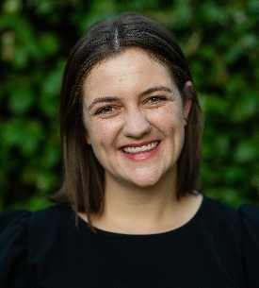
Meet Today’s Speakers
Carrie Schmaus
U.S. Department
of Energy
Wallie Zoller
Rockwell Automation
Carolyn Hull
Medical Imaging and Technology Alliance
Carrie
Notes:
Carrie will let panelists introduce themselves (except virtual panelists, who carrie will intro)

Slide 4
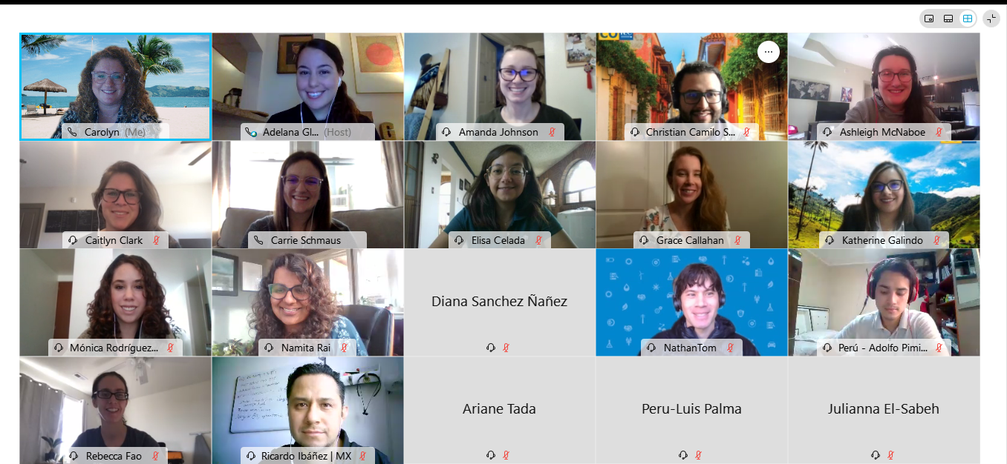
Welcome to our first USNC YEP Hybrid Event!
This photo was taken during a virtual meeting hosted with USNC and other international YEPs as part of our regional outreach program in the Americas. Let’s take a look at who’s in the hybrid meeting today? Turn on your cameras so we can see who’s online and in the room today!
Carrie
Notes:
carrie

Slide 5
What should you expect this afternoon?
Session Timeline
1:00–1:40pm Presentation and Q&A
1:40–2:00pm Facilitated Feedback Session
2:00–2:15pm Break
2:15–4:00pm Working Session
Carrie
Notes:
carrie

Slide 6
What should you expect this afternoon?
Presentation Outline
Welcome
Overview of the National YEP Program
National YEP Program History
Current efforts in the National YEP Program
Events
Testimonials
Future Vision
Q&A
Carrie
Notes:
Carrie – and we are excited this is hybrid event, welcome to our online participants!

Slide 7
Who is a Young and Emerging Professional?
The USNC Young and Emerging Professionals (YEP) Committee focuses on the advancement of professionals that are just beginning or early in their standards or conformity assessment careers
  A YP is anyone with less than 8 years of experience
  in standards or conformity assessment
Participants can be employed by industry, the government, academic bodies, consumer organizations, or any other member of the U.S. standards and conformance community that uses, benefits from, or contributes to the IEC's work in electrotechnical standardization and conformity assessment
Carolyn
Notes:
Carolyn

Slide 8
Establishing a National YEP Program in the U.S.
Goals & Strategic Objectives
Help YEPs engage their companies in USNC/IEC activities,
increasing organizational visibility and exposure
Provide mentorship, knowledge transfer, and skill sharing
Facilitate connections between US and international YEPs, beginning with a regional program in the Americas
Increase outreach to a diverse group of YEPs
Foster connections among YEPs involved in standards and conformity assessment in the US
Carolyn
Notes:
Carolyn

Slide 9
Establishing a National YEP Program in the U.S.
Mission
Inspired by other countries' programs, the USNC YEP Committee set out to establish a US national program
YEP Committee members identified strategic objectives, challenges and solutions, value proposition, and an action plan in the National YEP Program Framework
To build a community of future standards and conformity assessment professionals in the United States
Process
Inspiration
Wallie
Notes:
Wallie

Slide 10
Value in Participation
Community Building
Open Exchange of ideas
Personal Impact
Network and Mentorship Opportunities
Exposure to Cross Functional Focus Areas
Wallie
Notes:
Wallie

Slide 11
Establishing a National YEP Program in the U.S.
Implementation Plan Best Practices
Currently four (4) Task Forces established to address and support National YEP Program’s goals and strategic objectives
  Diversity, Equity, and Inclusion Task Force
  International Collaboration Task Force
  Outreach & Recruitment Task Force
  Programming & Events Task Force
Maintain group engagement and activity by alternating monthly YEP Committee meetings and task force meetings
Carolyn
Notes:
Emily

Slide 12
Establishing a National YEP Program in the U.S.
Implementation Plan Best Practices (continued)
Consistent communication with USNC to build support for program
Development of a YEP webpage as a knowledge hub for new YEPs
www.ansi.org/usnc-iec/programs-activities/young-and-emerging-professionals
Contributing to the USNC Current for YEP perspectives on
USNC activities
Carolyn
Notes:
Emily

Slide 13
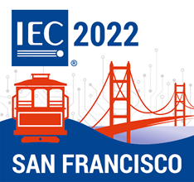
Upcoming Events & Opportunities
2022 IEC General Meeting in San Francisco
October 24 – November 4
USNC Young Professionals Competition
Applications due June 15
2022 IEC Young Professionals Workshop
October 31-November 4 in San Francisco
Contact USNC/IEC Staff Ade Gladstein (agladstein@ansi.org)
with any questions.
Carrie
Notes:
Carrie

Slide 14
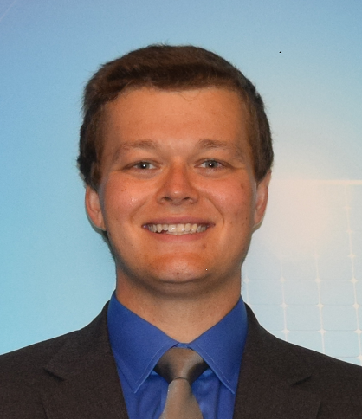
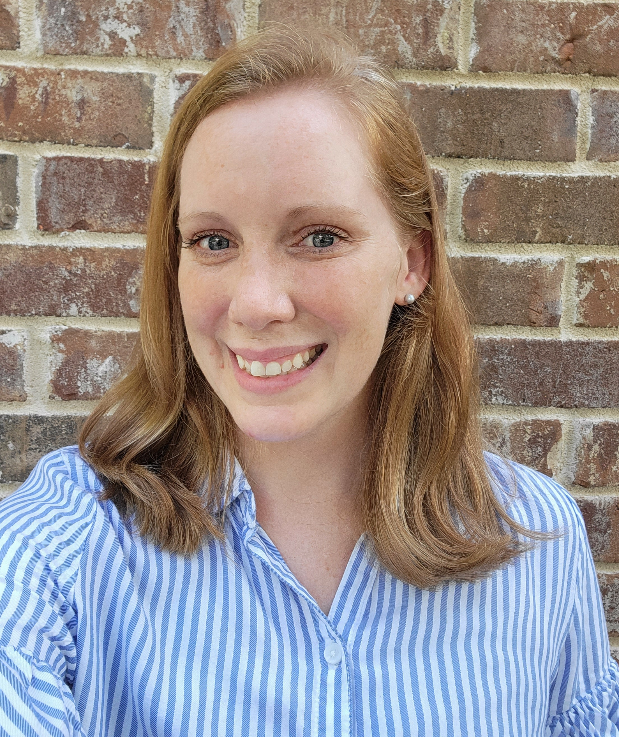
Testimonials
IEC YP Workshop 2021
Christopher Schmid
Underwriters Laboratories
Stephanie Schiller
Underwriters Laboratories
Carrie

Slide 15

Upcoming Opportunities
USNC Mentoring Program
Applications open this summer!
Contact USNC/IEC Staff Megan Pahl
(mpahl@ansi.org) with any questions.
Carrie
Notes:
Carrie

Slide 16
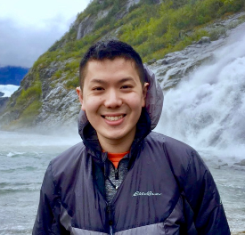
Testimonials
Sam Lum
Secretary, USNC YEP Program
Medical Device Standards Engineer
U.S. Food & Drug Administration
Carrie

Slide 17
Question & Answer
In person facilitator: Wallie Zoller
Virtual facilitators: Megan Pahl and Ade Gladstein
Wallie, Megan, Ade

Slide 18
Facilitated Feedback Session
Let’s Hear Your Thoughts!
Q1: How does the US YEP Program know when it’s been successful?
Carolyn

Slide 19
Facilitated Feedback Session
Let’s Hear Your Thoughts!
Q2: What is the role of international collaboration for the
National YEP Program?
Carrie

Slide 20
Facilitated Feedback Session
Let’s Hear Your Thoughts!
Q3: What are the main challenges the standards and
conformity assessment community is facing that the
US YEP Program can help address?
Wallie

Slide 21
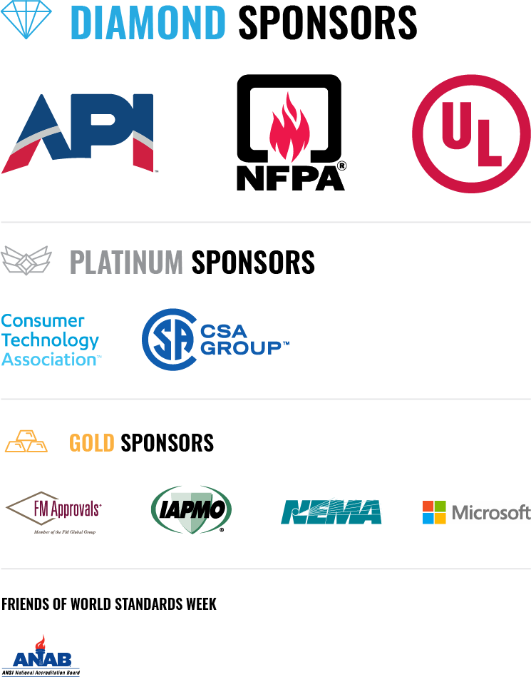
15-MINUTE BREAK
For virtual attendees, the Zoom will remain open.
Please turn your audio and video off if you are stepping away from the computer.
Carrie

Slide 22
Working Session #1
Parallel Sessions for In-Person and Virtual Attendees
Where do we want the USNC YEP Program to be in 2, 5, 10, and 10+ years?
Membership | Activities | Achievements | Partnerships | Capacity Building | Outreach | Other
Carrie & Eric

Slide 23
Working Session #1 Outcomes
What did you say in the In-Person and Virtual Breakouts?
Carrie and Eric

Slide 24
Working Session #2
Parallel Sessions for In-Person and Virtual Attendees
How do we engage with the standards and conformity assessment organizations to support opportunities for YEPs?
Carrie and Eric

Slide 25
Working Session #2 Outcomes
What did you say in the In-Person and Virtual Breakouts?
Carrie and Eric

Slide 26
Wrap Up
Major Takeaways
Next Steps
Carrie

Slide 27
Thank you!
For more information on USNC Young and Emerging Professionals,
please visit our website or contact usnc@ansi.org
www.ansi.org/usnc-iec/programs-activities/young-and-emerging-professionals
Carrie

Slide 28
Other World Standards Week Events of Interest
WEDNESDAY
WSW Spring Conference: Technology and the Workforce
10 am – 3 pm ET
ANSI Leadership and Service Awards (honoring 2020-2021 awardees)
6 pm – 9:30 pm ET
Reception: 6-7 pm
Dinner: 7-9:30 pm
THURSDAY
ANSI Legal Issues Forum: Forensic Standards and Conformity Assessment
10 am – 3 pm ET
U.S. Celebration of World Standards Day (2021 theme)
5:30 pm – 9 pm ET
For more information
and to register, visit
www.ansi.org/wsweek
Carrie

Slide 29
Networking Reception
4:00pm to 6:00pm
Join us for happy hour and a chance to connect with
YEP, USNC, and ANSI members!
In person attendees only*

